Slide 1

Loadshapes and
Smart Grid Simulations
Roger C. Dugan
Sr. Technical Executive, EPRI
Jacobs Hall, UCSD
Dec 14-15, 2010

Slide 2
Loadshapes and Smart Grid Simulations
Understanding how to use the LoadShape object is the key to performing many types of Smart Grid simulations
  Annual simulations
  Simulations with AMI data
  Renewable energy impacts

Slide 3
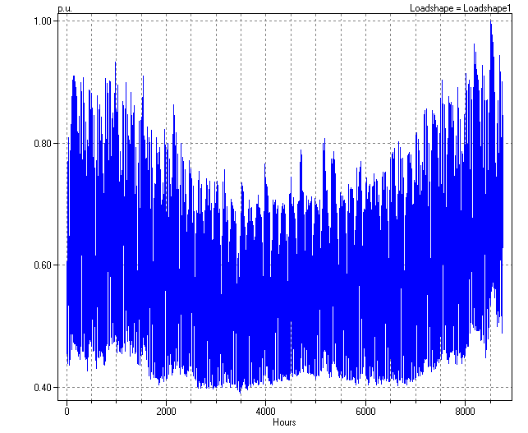
Winter-Peaking 8760-hr Load Curve

Slide 4
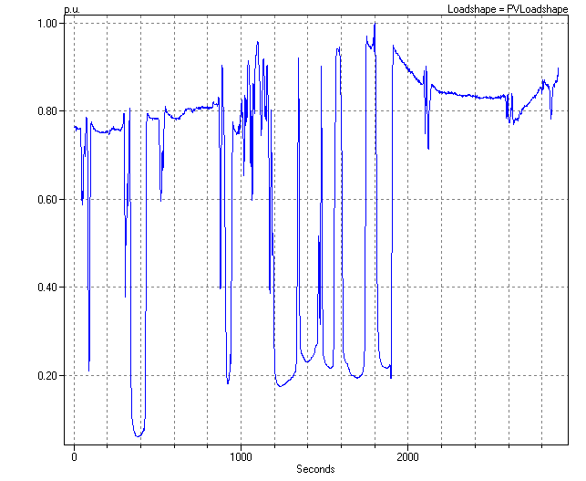
PV Loadshape

Slide 5
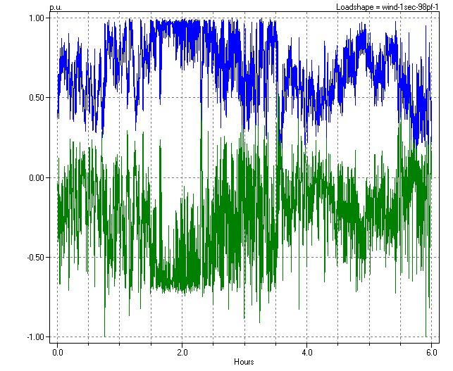
Example: Wind Turbine 1s Data
kW Multiplier
kvar Multiplier (normalized for 0.98 pf)

Slide 6
Defining the Wind Turbine Loadshape
(just some big number; gets reset to actual number of points found in ‘mult’ definition)
(1/3600 hr)
New (Loadshape.Wind-1sec-98PF-1) npts=100000 interval=0.000277778 action=normalize
~ mult=(file=Wind-P-1sec-2.CSV)
~ qmult=(file=Wind-Q-1sec-2.CSV)
! Define a Generator that uses the Loadshape
New Generator.MyWindGen Bus1=MyBus kV=12.47 kW=1500 PF=0.98
~ Duty=Wind-1sec-98PF-1
P and Q multipliers are in separate files
Assign shape to Duty Cycle property for 1s simulation
The Loadshape definition applies to 0.98 PF

Slide 7
Loading Array Properties from Files
Most numeric array properties in OpenDSS can be defined by the following techniques
  In the script
    … mult=[1 2 3 4 …]
  From text (CSV) files, one value per line
    … mult=(file=MyTextFile.CSV)
  From packed binary single-precision files
    … mult=(sngfile=MyFileofSingles.sng)
  From packed binary double-precision files
    … mult=(dblfile=MyFileofDoubles.dbl)

Slide 8
On the use of Packed Binary Files
Every load can have its own Loadshape
  AMI simulations, PHEV impact simulations, and other Smart Grid simulations require repeated reloading of Loadshapes
  Using packed binary files can save a lot of time
    6 – 10 times faster loading than text

Slide 9
On the use of Packed Binary Files
Options for creating packed binary files
  Create the files directly from the original data source
  Define once using text files; then use Loadshape “action” property
    … action=sngsave or …action=dblsave
    Creates a script for reloading the data
  The “CvrtLoadShapes” command converts all Loadshape objects presently defined
    Creates a script file for reading the data back in

Slide 10
The “UseActual” Property of Loadshapes
Normally, Loadshape values are assumed to be per unit multipliers times the base kW, kvar value
  Present kW = Base kW * Mult[hour]
    (The “action=normalize” property will convert actual values to per unit)
For AMI simulations it is more convenient to keep the Loadshapes in actual kW, kvar values
  New Loadshape.Myshape … mult=(file=myAMIdata.csv) useactual=yes

Slide 11
Side Effect of UseActual Property
Side effect:
  The kW property of Load or Generator is set to peak value of Loadshape “mult” array property
    Occurs when Loadshape is assigned to a Load
    The kvar property is set to the value of Qmult, if any, at the time of peak kW (the Mult array)
Why is this important?
  In Snapshot mode, the solver uses the values of the kW, kvar properties
  You generally want these to be reasonable values.
You can override this side effect AFTER assigning the Loadshape to a Load (or Generator)

Slide 12
For More Information …
See OpenDSS LOADSHAPE Usage.doc on the OpenDSS Sourceforge.Net site:
http://electricdss.svn.sourceforge.net/viewvc/electricdss/Doc/OpenDSS%20LOADSHAPE%20Usage.doc?view=log
(Then View or Download)
This is also on the Wiki

Slide 13
Together…Shaping the Future of Electricity

